Slide 1
Employee Data Analysis using Excel
STUDENT NAME: Vishnu Priya M
REGISTER NO: 122204083 asunm1659122204083
DEPARTMENT: Corporate Secretaryship
COLLEGE: Shri Krishnaswamy college for women

Slide 2
PROJECT TITLE
Employee Gender Analysis using Excel

Slide 3


AGENDA
Problem Statement
Project Overview
End Users
Our Solution and Proposition
Dataset Description
Modelling Approach
Results and Discussion
Conclusion
3/21/2024 Annual Review

Slide 4

PROBLEM STATEMENT
"The goal of this project is to conduct a comprehensive gender analysis of [specific area or industry] to identify and address gender disparities, inequalities, and opportunities for empowerment. Through a mixed-methods approach, combining quantitative and qualitative data collection and analysis, this project aims to:By exploring the intersections of gender with other social categories, such as race, class, age, and sexuality, this project seeks to provide a nuanced understanding of gender experiences and inform strategies for transformative change."

Slide 5

PROJECT OVERVIEW
- Research and analysis of existing data and literature on gender-based inequalities - Primary data collection through surveys, interviews, and focus groups - Case studies of organizations, communities, or policies with innovative gender equity initiatives - Identification of best practices and lessons learned

Slide 6

WHO ARE THE END USERS?
Employees
HR Personnel
Managers/Supervisors
Payroll Department
IT/Admin Staff

Slide 7

OUR SOLUTION AND ITS VALUE PROPOSITION
1.*Informed Decision-Making*: Data-driven insights to guide policy and business decisions
2. *Improved Outcomes*: Enhanced performance, reputation, and social impact through inclusive practices
3. *Increased Diversity*: Foster a culture of equality, diversity, and belonging
4. *Competitive Advantage*: Stay ahead with gender-smart strategies and empowered teams
5. *Social Impact*: Contribute to a more equitable society through gender equality and empowerment

Slide 8
Dataset Description
Employee-kaggle 26 features 9-features Employee ID – number Name-text Employee type Proformance level Gender-Male,Female Employee rating-number

Slide 9

THE "WOW" IN OUR SOLUTION
When someone makes us feel appreciated, respected and heard, we are impressed. ‘Wow’ is down to how you make your customers feel. That is what they’ll remember.
3/21/2024 Annual Review
9

Slide 10
MODELLING
DATA COLLECTION 1 Kaggle 2 selecting data 3 grouping up into Excal FEATURE COLLECTION Employ name Empolyee ID Employee rateing empolyee gender PROFORMANCE LEVEL Exceptional Performance Above Average Performance Benchmark Performance
10

Slide 11
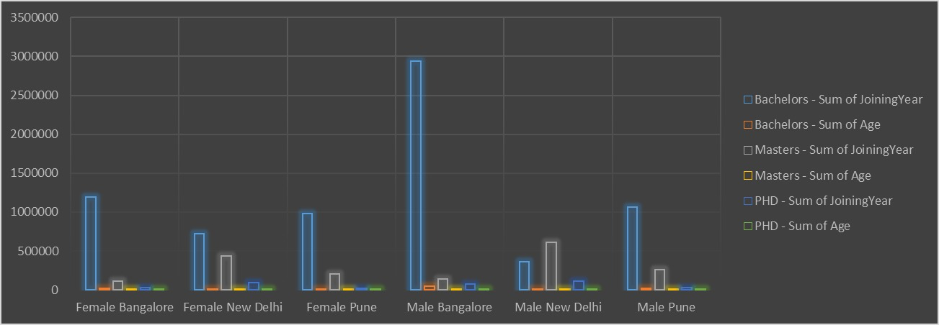
RESULTS
11

Slide 12
conclusion
"In conclusion, our gender analysis has revealed significant insights into the gender dynamics and disparities within [specific area or industry].
The findings highlight the need for intentional efforts to address gender inequalities and empower underrepresented groups.
This gender analysis serves as a crucial step towards a more gender-aware and responsive [organization/industry].
We look forward to continued collaboration and progress towards a more equitable future."

